Slide 1
Zenodo Publishing
WP2 T3

Slide 2



Learning Objectives
Describe the automated workflows for publishing the learning materials on Zenodo
Author new version releases of the learning materials
Examine draft publications on Zenodo

Slide 3
Agenda
Introduction to the Automated Workflows
Zenodo Configuration
GitHub Configuration
Zenodo Draft Verification

Slide 4

Introduction to the Automated Workflows
Automated Workflows = a set of actions executed automatically upon a given event (e.g., new commit)
Free feature provided by GitHub
The templates repository has various workflows predefined and ready to be used by any forks
Not enabled by default on new forks (security precaution)
Goal: Make the publishing process as automated as possible, eliminating time consuming actions which are prone to errors
Image by Sean Harrington from Pixabay

Slide 5
Meeting the Automated Workflows
Validate existing CITATION.cff metadata
Update automatically managed CITATION.cff fields (doi, version, date-released)
Create a draft entry on Zenodo and prereserve a DOI
Update existing files in the repository referencing the DOI (syllabus, last PowerPoint slide)
Rebuild the Git book with new citation and DOI information
Release a new version of the Git book

Slide 6
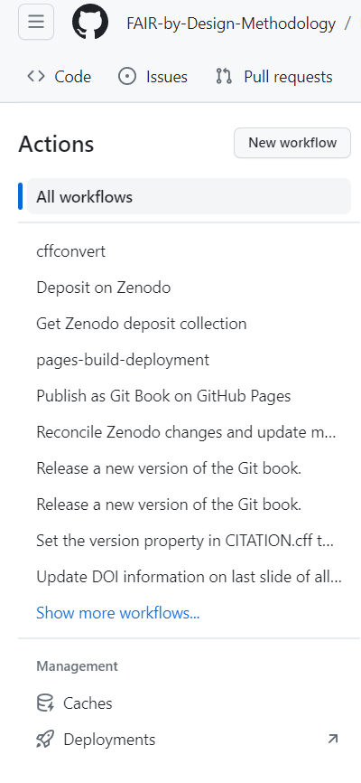
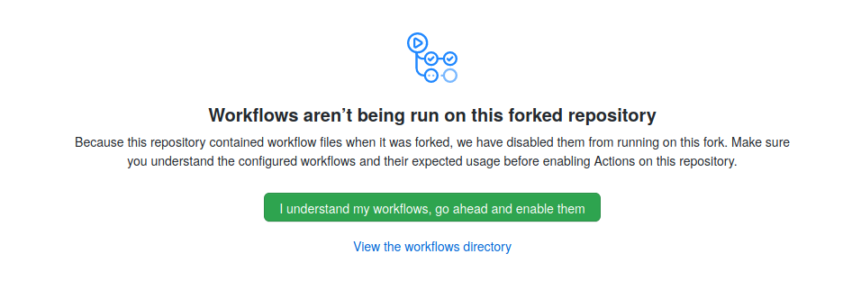
First Things First
Verify that the inherited workflows from the upstream repository are enabled in the fork
Fork’s homepage -> Actions -> “I understand my workflows, go ahead and enable them”
If no green button is present, then the workflows have already been enabled

Slide 7
Configuring Zenodo (1)
The automated workflows need to communicate with Zenodo
Special credentials are required
Can be generated from the user configuration page on Zenodo
Create a new or login with an existing account on zenodo.org
Generate a new “Personal Access Token”
Profile dropdown menu -> Applications -> New token
Name: arbitrary
Scopes: deposit:write
Write down the generated token, it will be required shortly
Make sure to keep it secret!

Slide 8
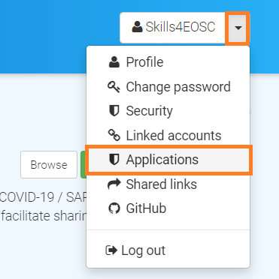
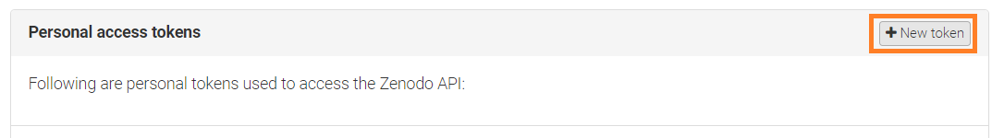
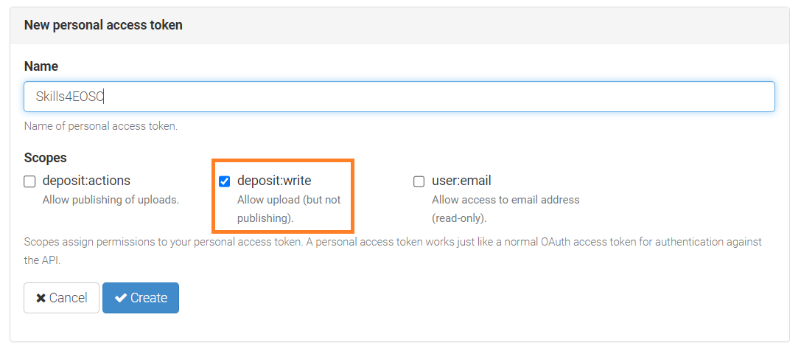
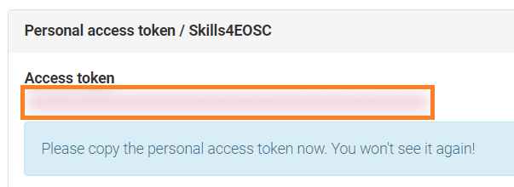
Configuring Zenodo (2)
1.
2.
3.

Slide 9
Configuring GitHub (1)
The generated Personal Access Token should be added as a GitHub Secret
Workflow steps can reference the GitHub Secret and use it for interacting with Zenodo
Fork’s homepage -> Settings -> Secrets and Variables -> Actions -> New Secret
Name: ZENODO_ACCESS_TOKEN
Secret: the generated personal access token

Slide 10
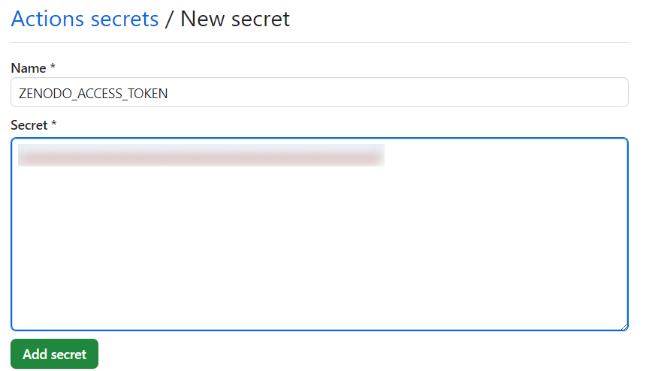
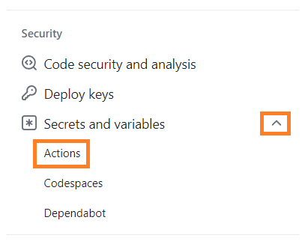
Configuring GitHub (2)
Navigation pane in the forked repository’s settings
Registering the generated Zenodo Personal Access Token

Slide 11
Creating a New Version Release (1)
First release, after the initial iteration over the learning materials
The publishing workflows are kicked off by creating a new “GitHub Release”
Fork’s homepage -> Releases -> Create a new release
The release version is specified as the release “tag”
e.g., 1.0.0
The release title should be set to the same value as the tag
e.g., 1.0.0
Clicking the Publish release button starts the workflows

Slide 12
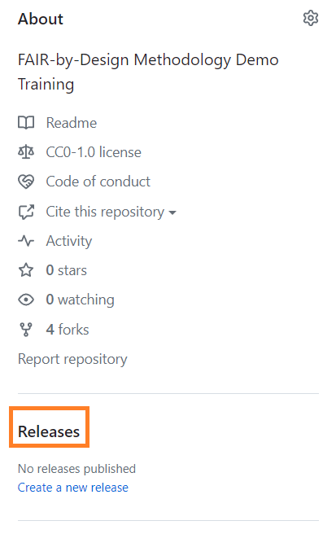
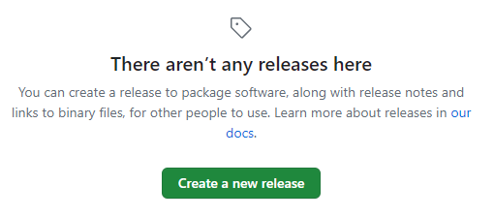
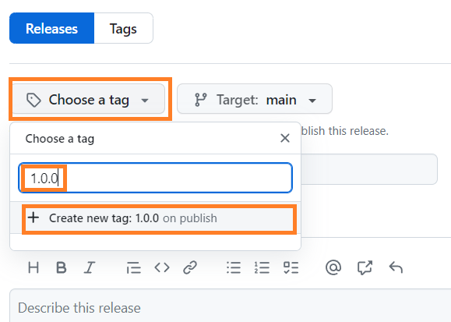
Creating a New Version Release (2)

Slide 13
Intermission: What’s with all those numbers?
1.0.0 = semantic versioning
1. = major version number
Major changes to the material or a complete rewrite
0. = minor version number
Small changes to the material, e.g. extension of existing or addition of a new learning unit
0 = patch version number
Technical changes, e.g. typos, references, formatting improvements

Slide 14

Grab a Coffee…
The automated workflow steps will be executed in the background
Progress can be monitored in the “Actions” tab
Estimated time: 5-10 minutes, so grab a cup coffee…
If an error occurs, the repository owner will receive an email message
Image by Alexa from Pixabay

Slide 15

Verifying the Release (1)
Navigate to the Git book homepage
Check the footer
Citing information
Latest version
DOI
New version in the version drop down menu at the top of the page
Check the syllabus for the new DOI
Pull the latest changes locally using GitHub Desktop
Open an arbitrary PowerPoint file and verify that the citing information has been updated
Image by GraphiMama-team from Pixabay

Slide 16
Verifying the Release (2)
Navigate to zenodo.org and log in
Click on the “Upload” button in the header
A draft release should be present
The draft is not publicly visible at this point
Open the draft record and verify that all metadata has been correctly transferred from the Git repository
Pay attention to the Zenodo community, authors, license, funding information
Manually set the language of the materials
Save changes using the “Save” button
Publish the release using the “Publish” button
⚠
Publishing on Zenodo is an irreversible action, so make sure to double check all of the information while the deposit is still a draft.
Image by GraphiMama-team from Pixabay

Slide 17
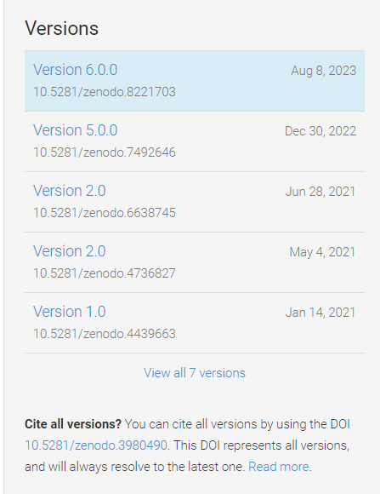
Key Takeaways
The same steps can be repeated for any future releases
The Zenodo Personal Access Token doesn’t need to be regenerated
When a new version is published, the workflow will automatically link it to the existing Zenodo record

Slide 18
Publishing in Practice
Using the forked templates repository, release the first version of your demo learning materials

Slide 19
Thank you! Any questions before we continue?
vojdan.kjorveziroski@finki.ukim.mk
Cite instructions on: https://doi.org/10.5281/zenodo.10063110

